Slide 1
PDF ChatBot

Slide 2
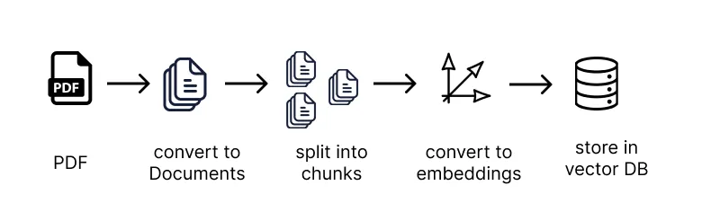
PDF processing

Slide 3
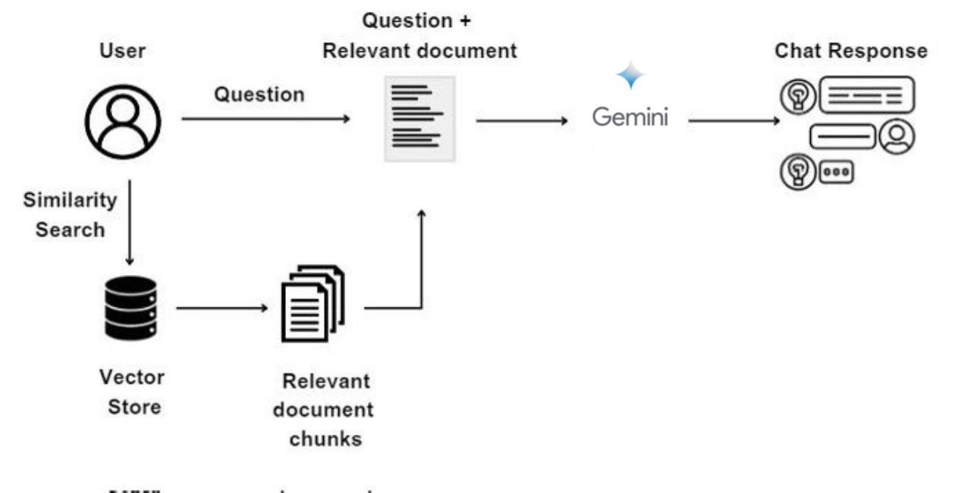
Architecture Overview

Slide 4
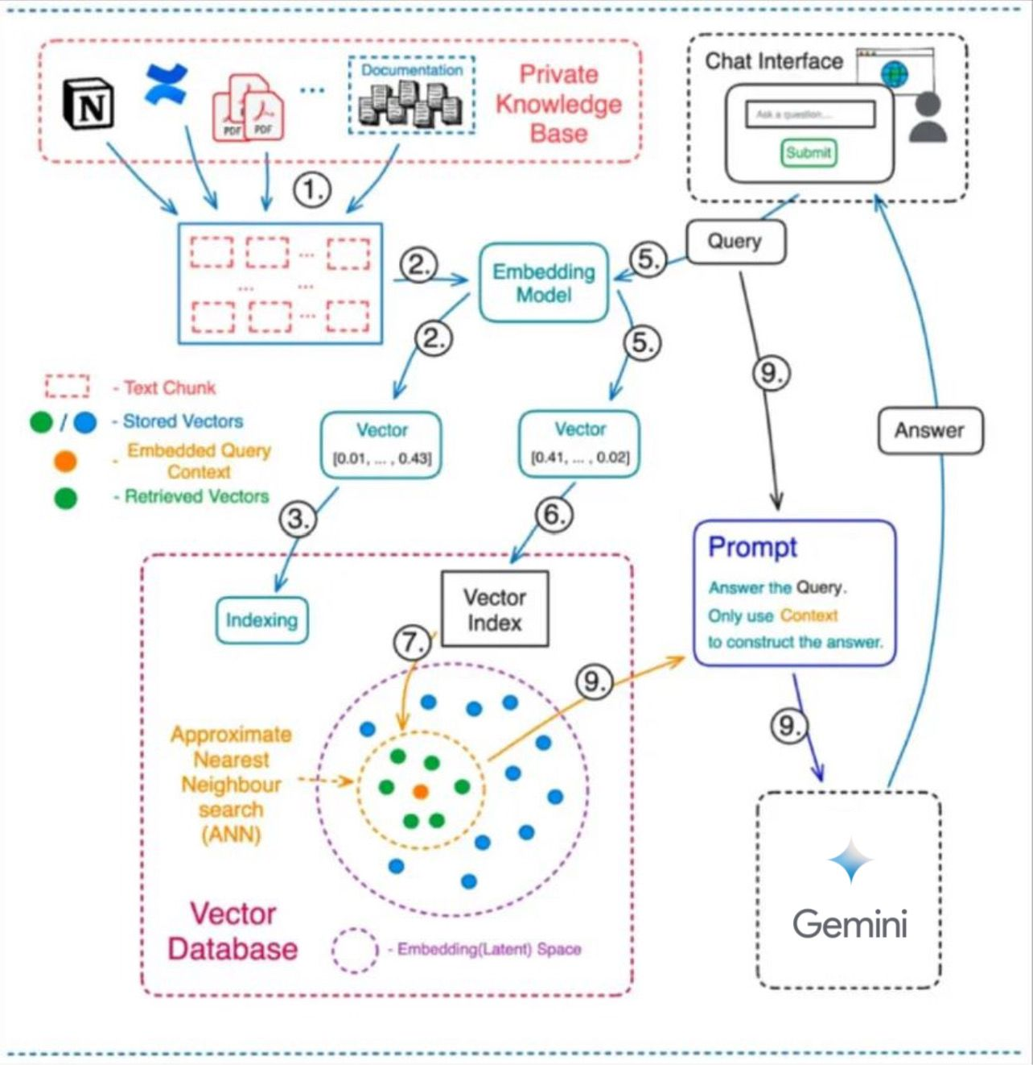
Detailed Workflow
Knowledge Base Input
Embedding Model
Indexing and Vector Storage
Query Processing
Vector Database Search
Retrieving Relevant Chunks
Prompt Construction
Response Generation

Slide 5
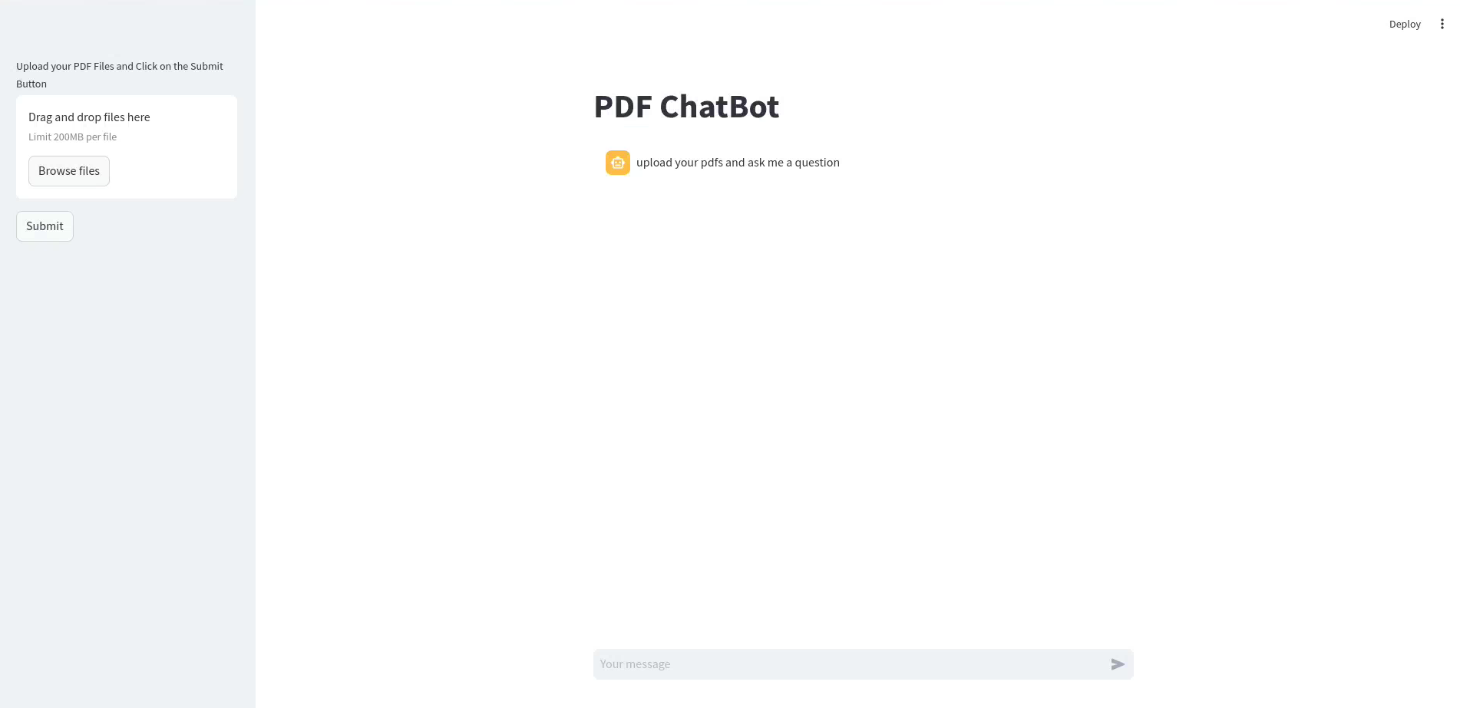
Deployment Instructions
Docker build -t <Dockerfile> .
Docker run -it -p 8501:8501 <dockerfile> bash
Streamlit run <python_script>

Slide 6
User Interface
1
Add PDFs
Submit it for processing
question/answer interface
2
3

Slide 7
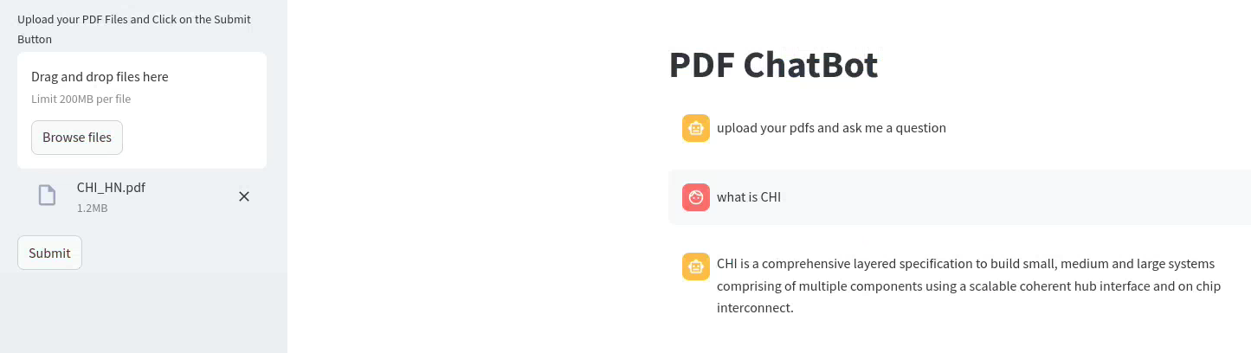
Usage Instructions

Slide 8
Thank You

